Slide 1
For Diversity Scholars Who Have Considered Activism When Scholarship Isn’t Enough!
Oscar Holmes IV, Ph.D.
Oscar.HolmesIV@Rutgers.edu
@OHIV

Slide 2
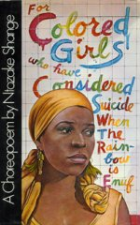
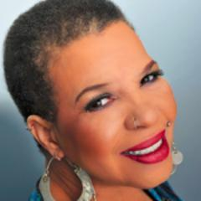
For Colored Girls Who Have Considered Suicide When The Rainbow Is Enuf

Slide 3
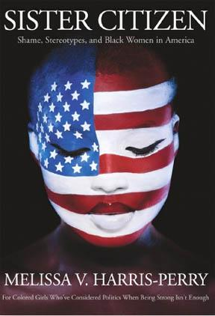
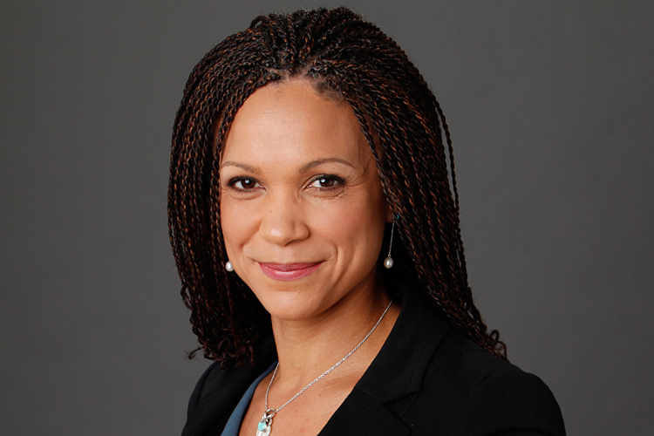
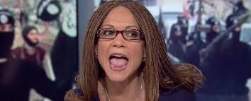
For Colored Girls Who Have Considered Politics When Being Strong Isn’t Enough

Slide 4
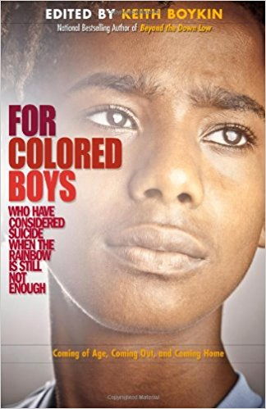
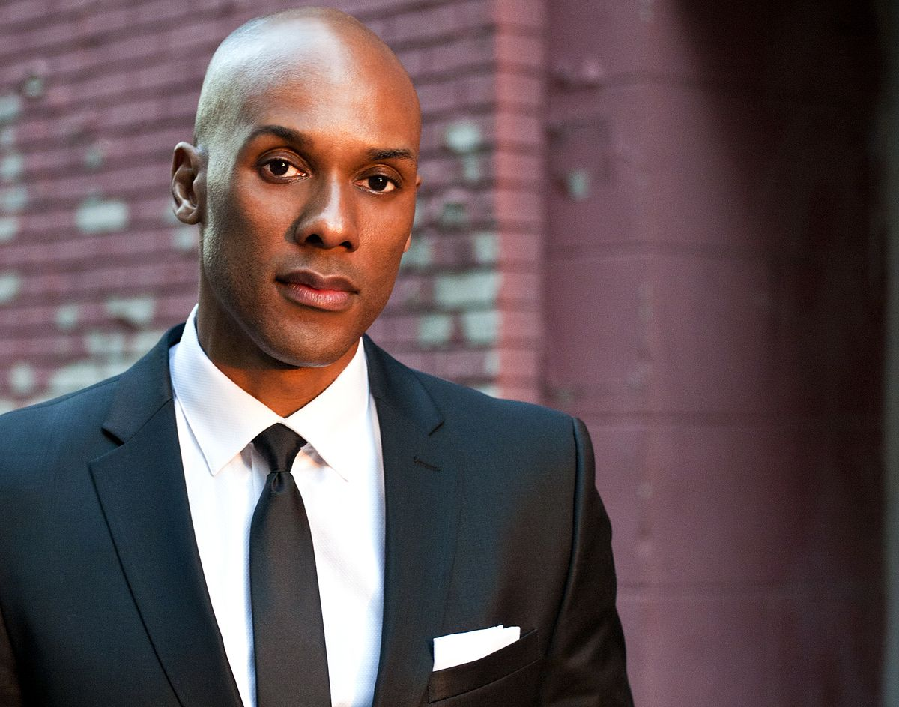
For Colored Boys Who Have Considered Suicide When The Rainbow Is Still Not Enough

Slide 5

“At The individual level, psychological and social boundaries and levels of comfort with difference and diversity can be framed as micro level borders.” ~Dr. Joana Vassilopoulou, Brunel University, EDI Conference Chair

Slide 6

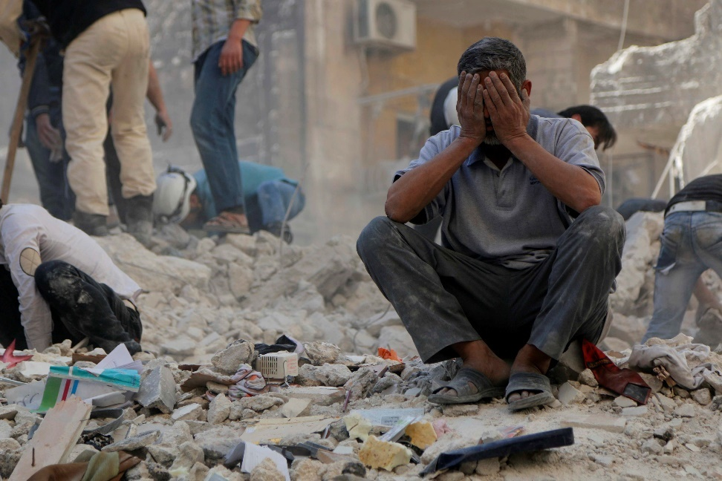
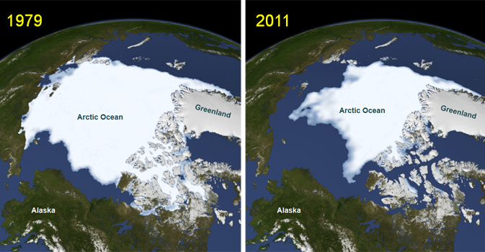
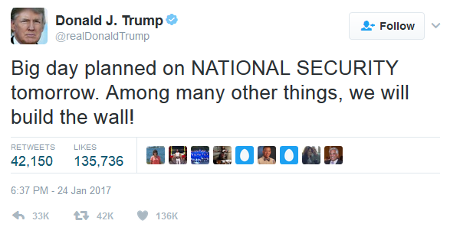

Slide 7



Slide 8
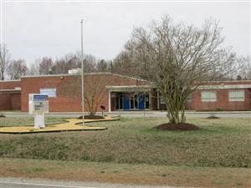
Lawson-Marriott Elementary/Middle School

Slide 9
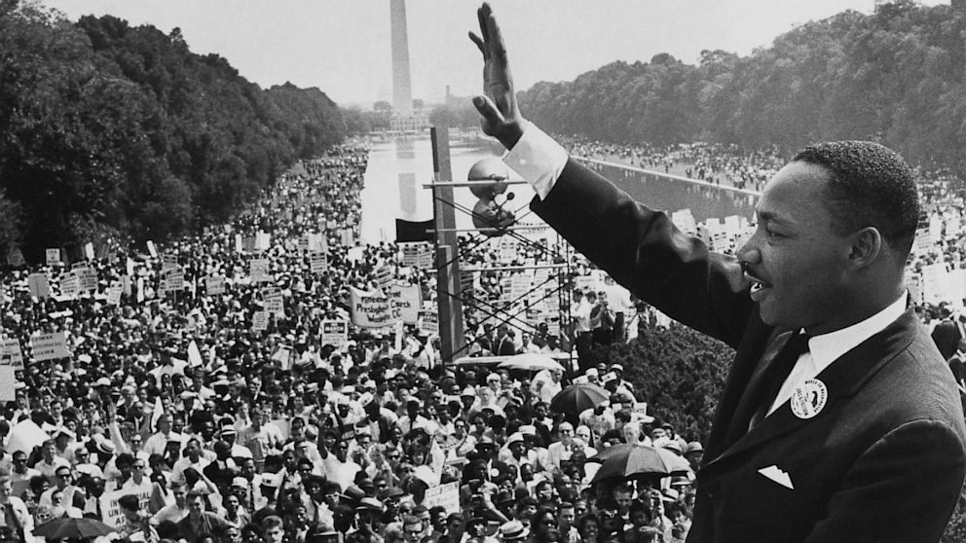
“…an oasis of freedom and justice.”

Slide 10
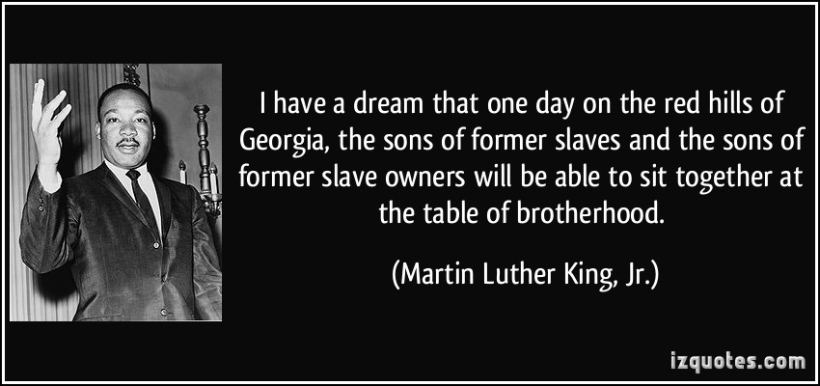

Slide 11
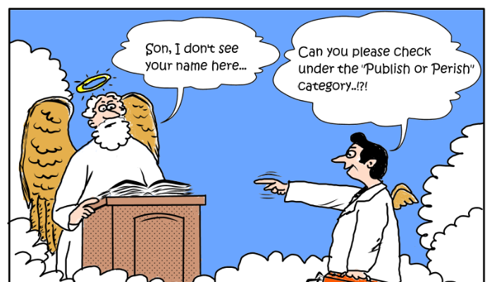

Slide 12
For Diversity Scholars Who Have Considered Activism When Scholarship Isn’t Enough
Step 1
1. Translate Research For The General Public

Slide 13
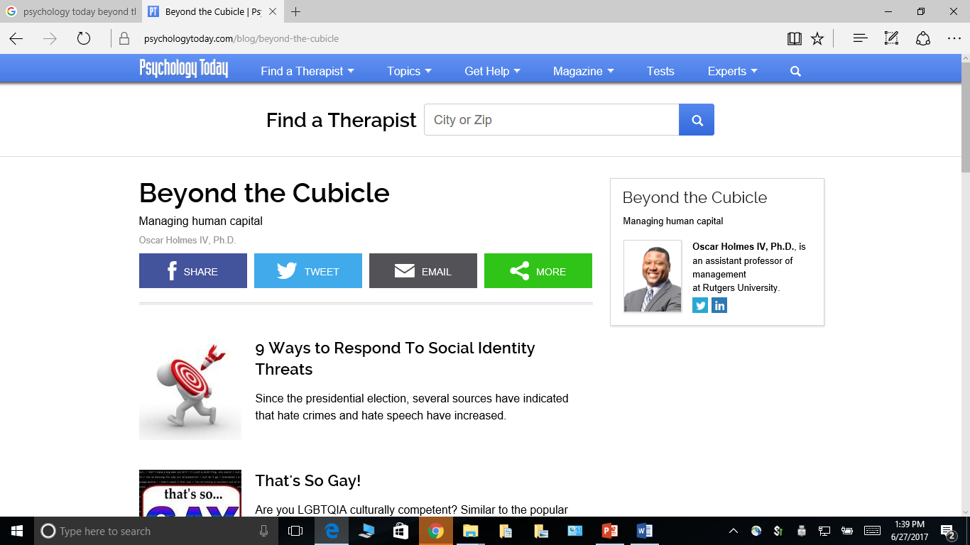

Slide 14
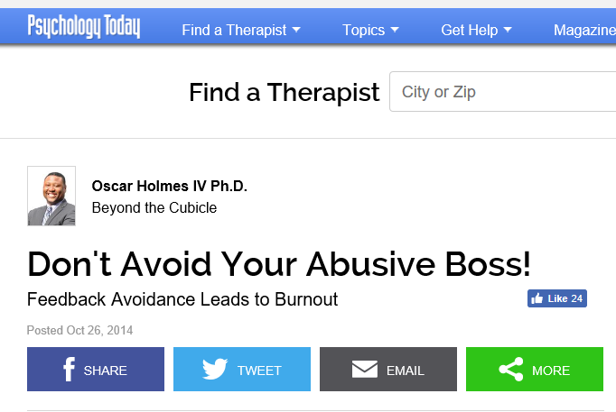
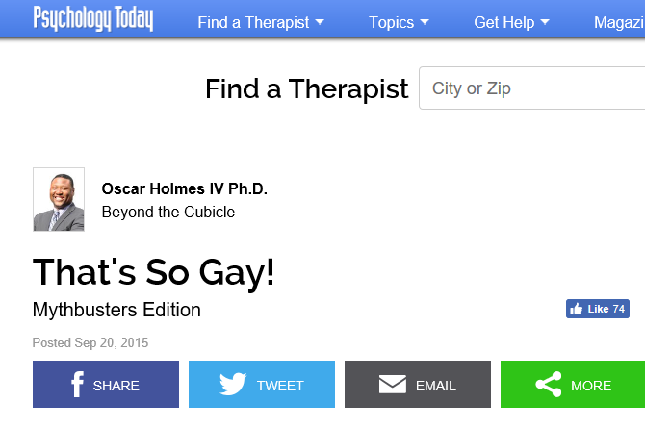
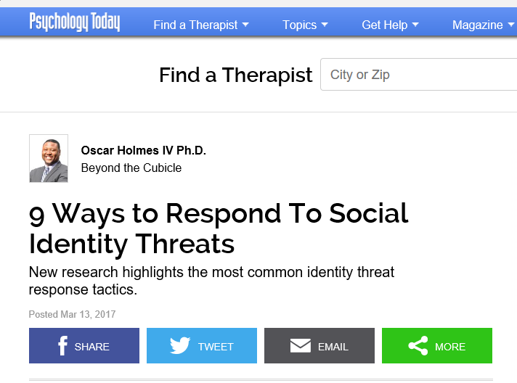

Slide 15
For Diversity Scholars Who Have Considered Activism When Scholarship Isn’t Enough
Step 2
1. Translate Research For The General Public
2. Partner with Activist Groups

Slide 16
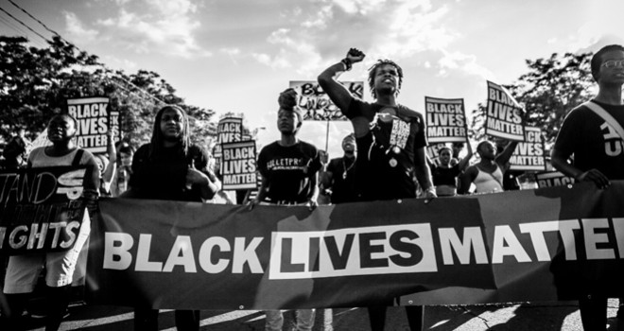

Slide 17
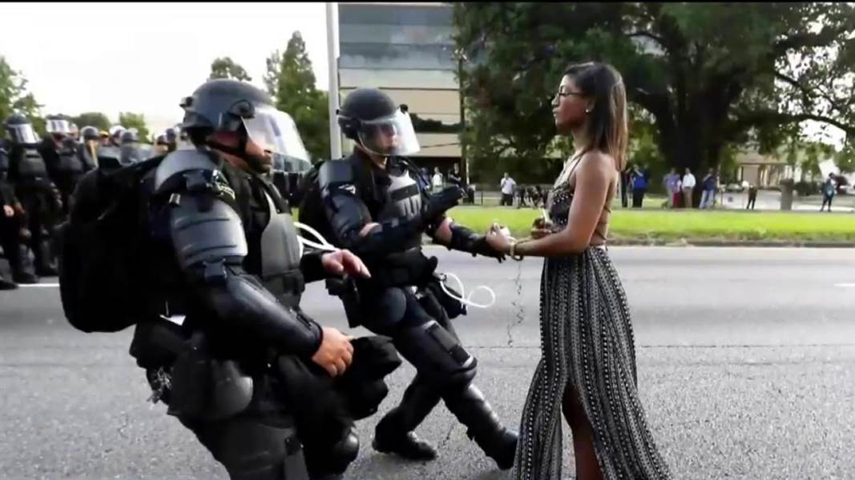
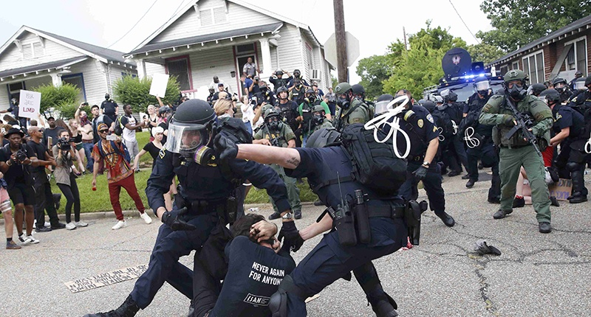

Slide 18
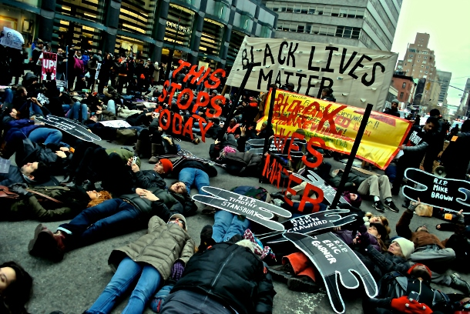
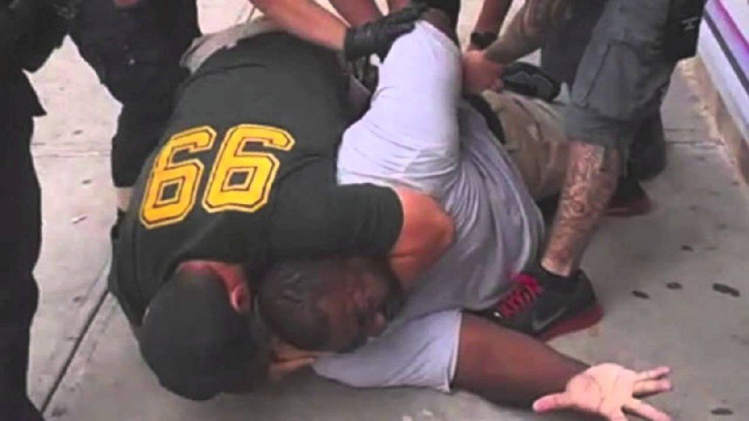
“I Can’t Breathe!”

Slide 19
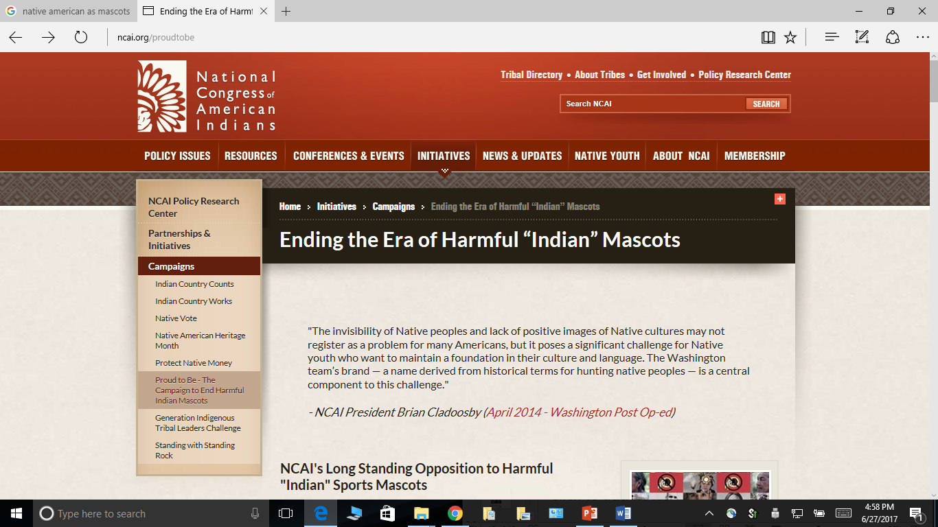
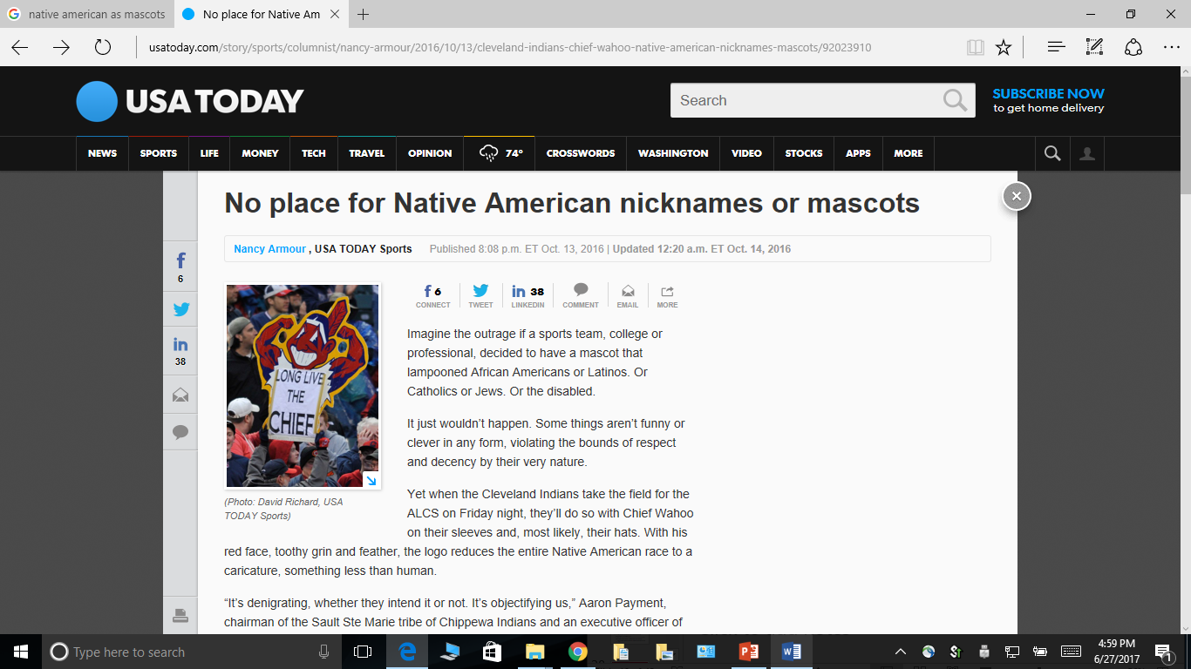
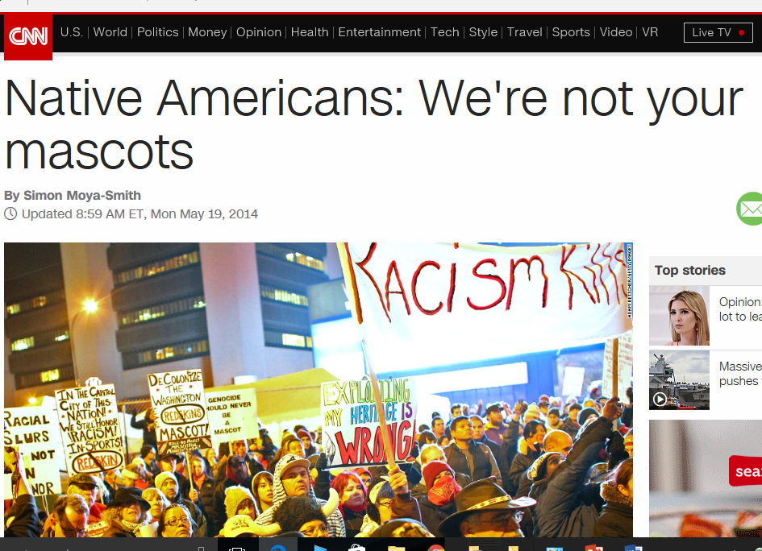

Slide 20
For Diversity Scholars Who Have Considered Activism When Scholarship Isn’t Enough
Step 3
1. Translate Research For The General Public
2. Partner with Activist Groups
3. Call Out Respectability Politics & False Equivalencies

Slide 21

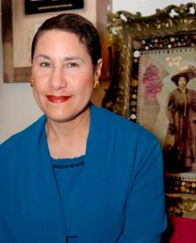
Respectability Politics

Slide 22
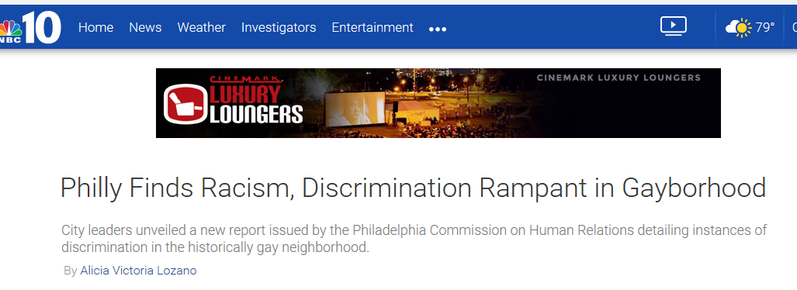
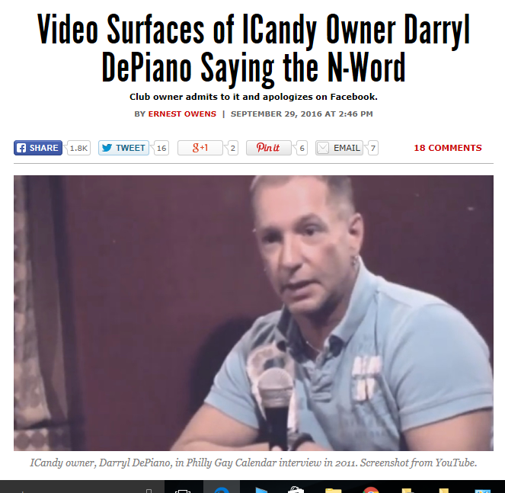
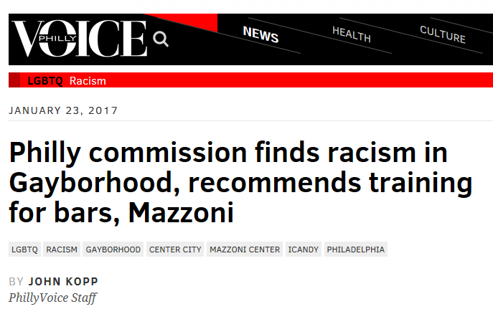

Slide 23
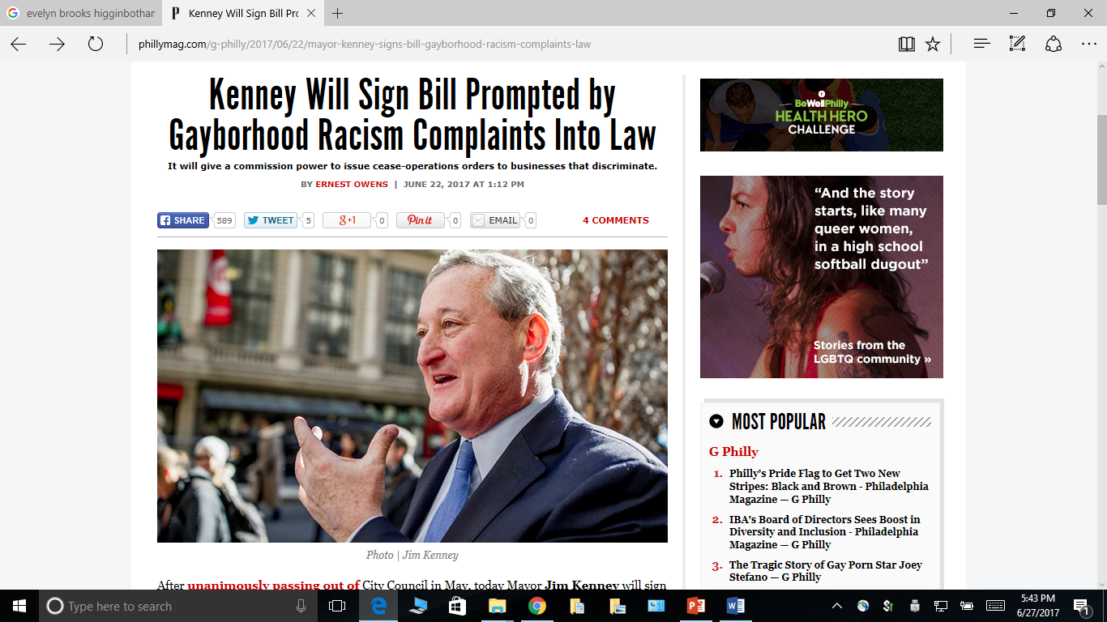

Slide 24
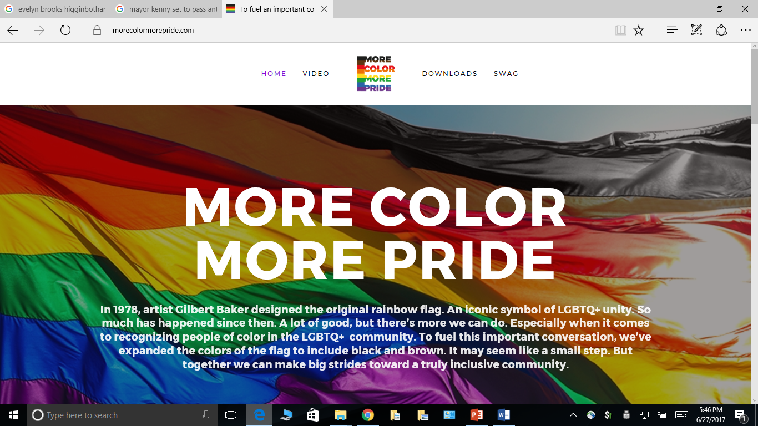
www.MoreColorMorePride.org

Slide 25

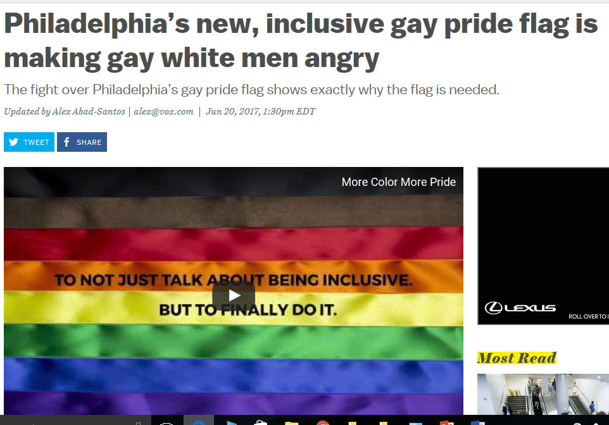


Slide 26
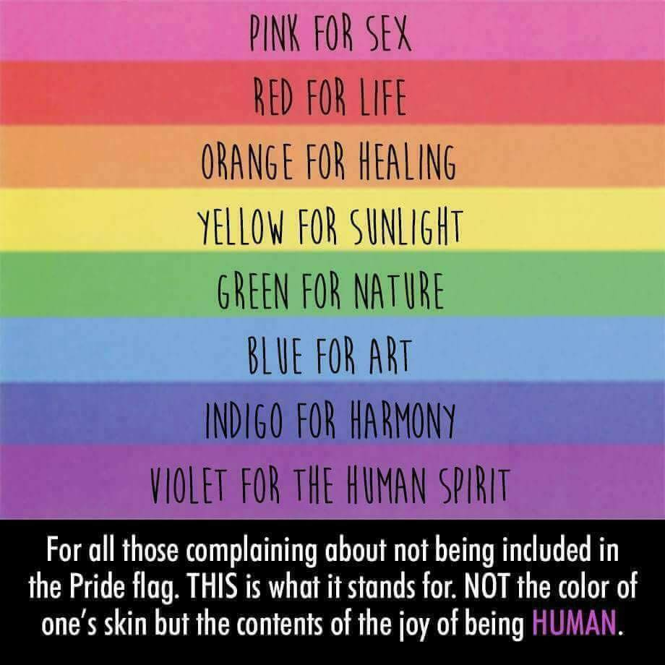
“…this new pride flag conceptualization missed the mark by interpreting the colors of the flag as skin color rather than elements of the human experience.”

Slide 27
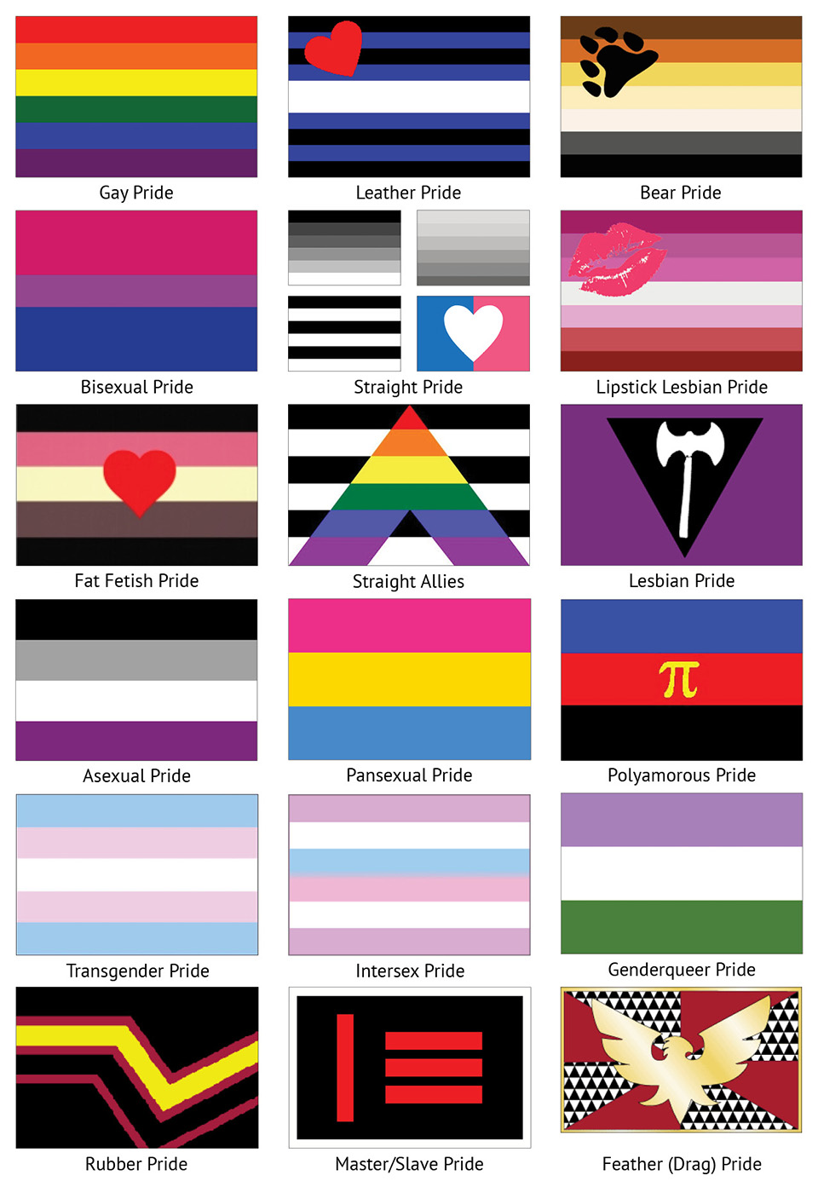

Slide 28
“…this new pride flag conceptualization missed the mark by interpreting the colors of the flag as skin color rather than elements of the human experience.”

Slide 29
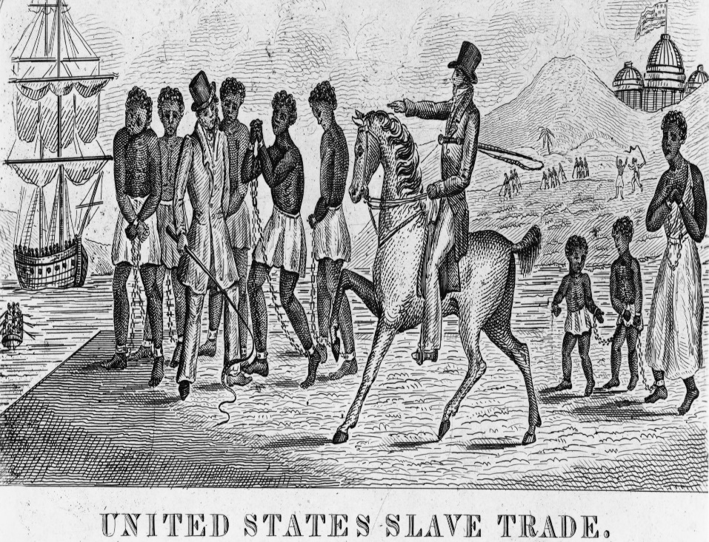
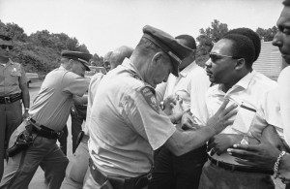
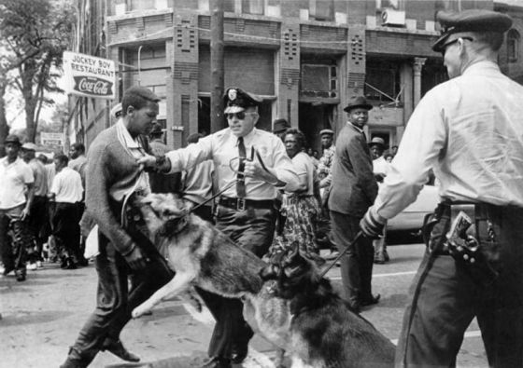
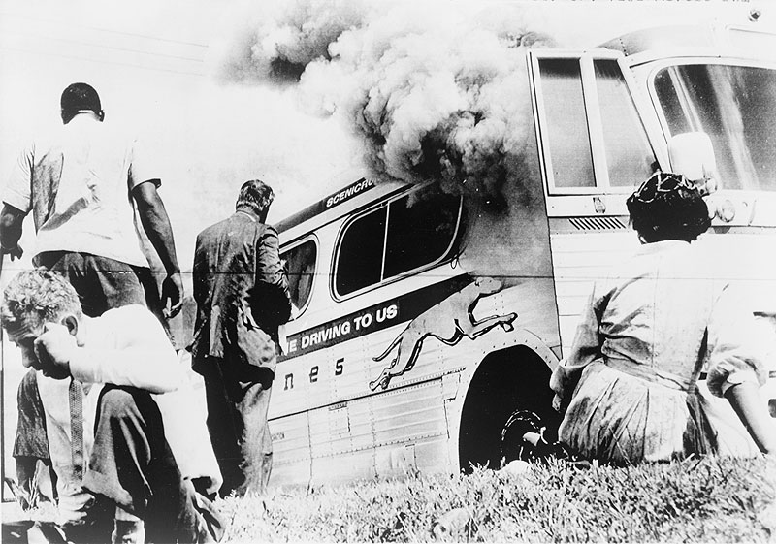

Slide 30
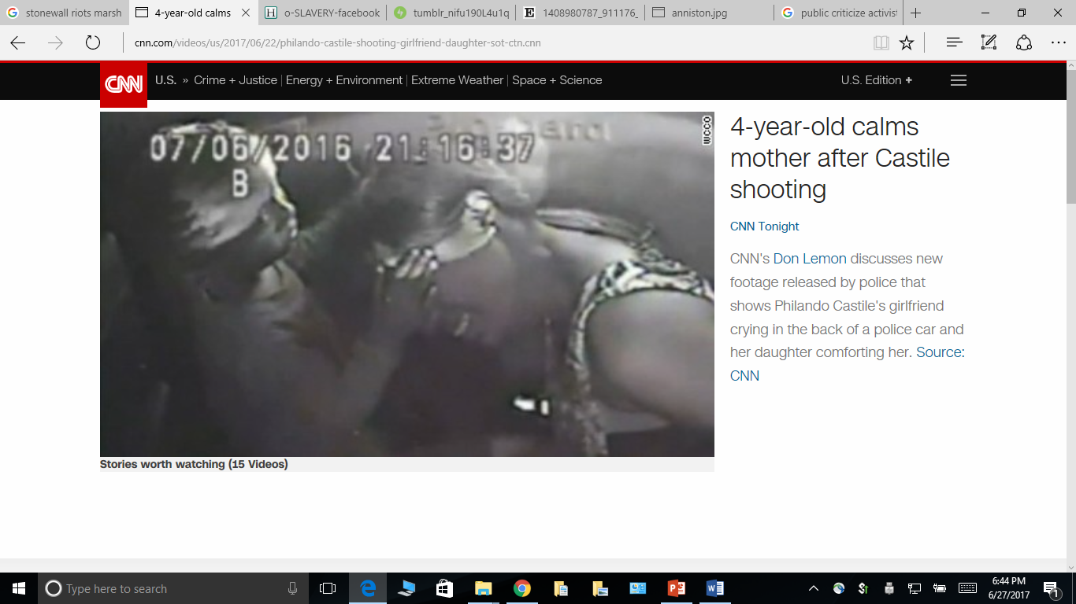

Slide 31
For Diversity Scholars
Who Have
Considered Activism
When Scholarship
Isn’t Enough!

